Slide 1
Team “NextGenTech” welcomes you to have a quick glimpse of the Hackathon solution as “Intelligent eMail System (IES)” that parses, automates, categorizes and generates Service Request from eMail/s

Slide 2
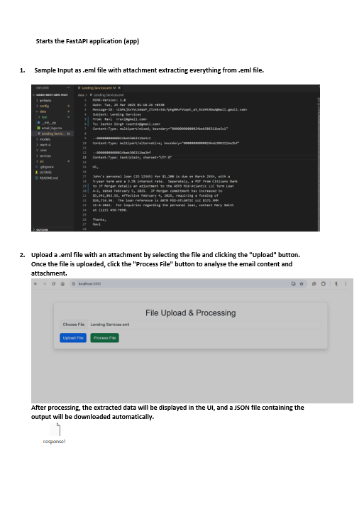
Sample eMail
Load Sample eMail to the processing storage

Slide 3
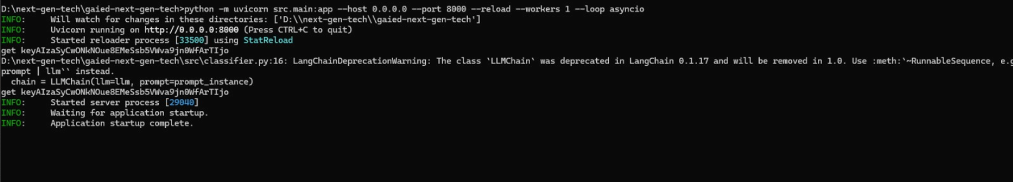
Submit the process

Slide 4
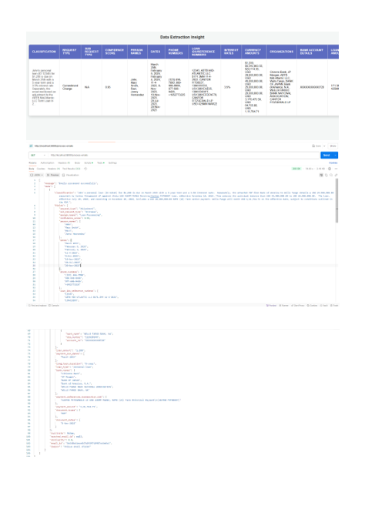
Output displayed through UI
Lower section is JSON Output (Returned by LLM)

Slide 5
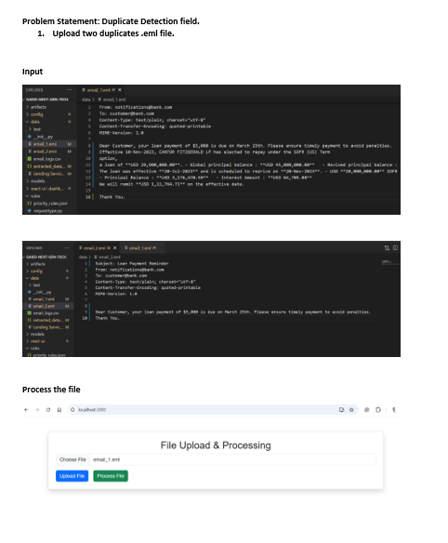
Scenario – Duplicate eMails
Simulating 2 eMails with similar context

Slide 6
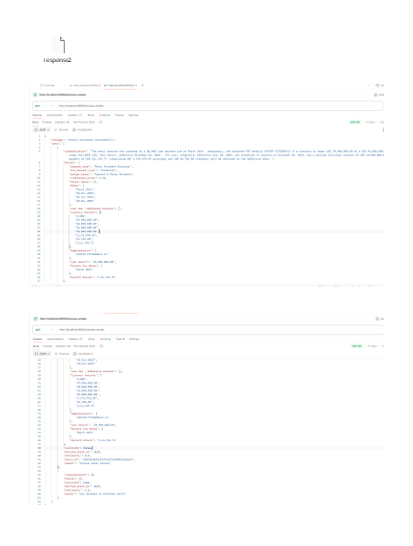
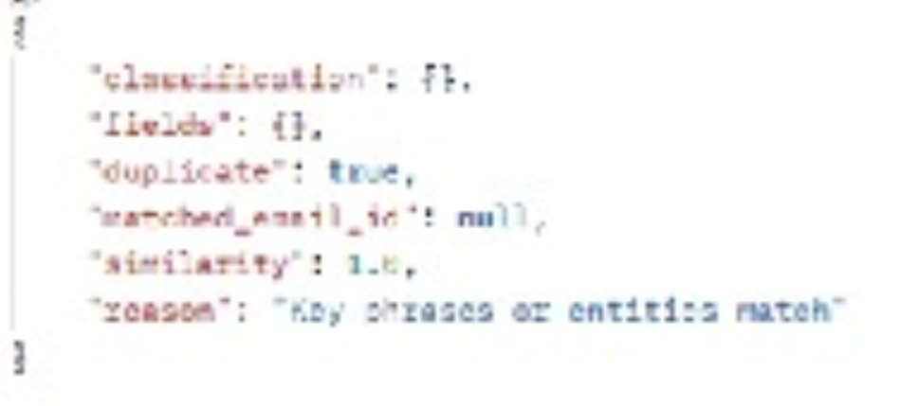
Scenario – Duplicate eMails Output
Simulating 2 eMails with similar context (Result shows , “Duplicate”: true , and “similarity”:1.0)

Slide 7
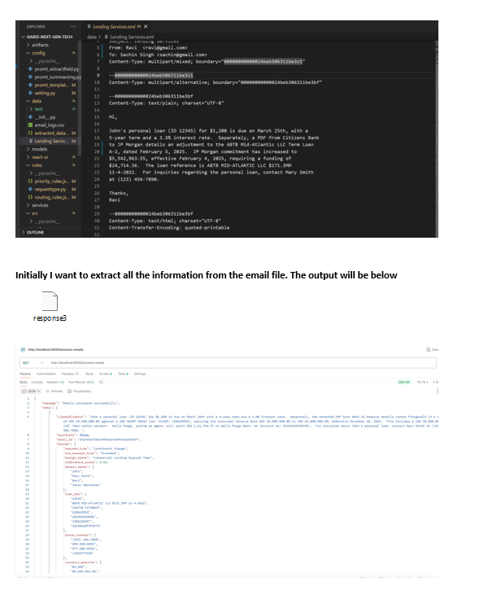
Scenario –Prioritization based on Request Types
Step1 : Extract all incoming Attributes for each request Type

Slide 8
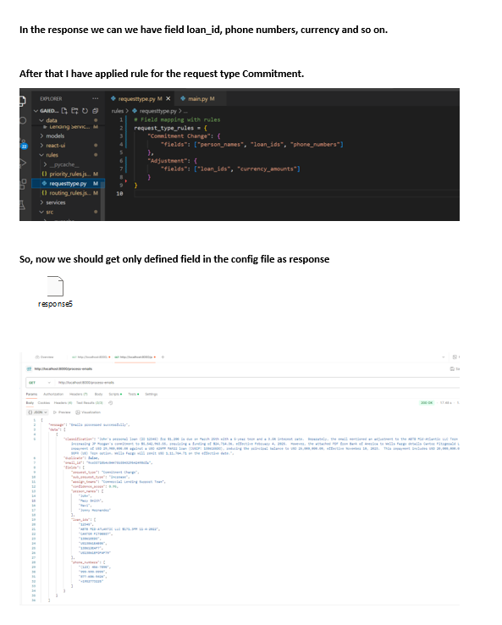
Scenario –Prioritization based on Request Types
Step2 : Filtering only requested fields per Config File (Shown above)

Slide 9
Thank You

